Slide 1
Artificial Intelligence
Lecture: 3

Slide 2
The Structure of Agents
The Artificial intelligent (AI) system is composed of two different things
Agent
Environment
Agent:
An agent is an entity that perceives its environment through sensors and takes actions using actuators to achieve a specific goal.

Slide 3
Components of an Agent
An AI agent consists of:
Agent Program: The algorithm/software that decides what action to take based on percepts.
Agent Architecture: The physical or software-based framework on which agent program runs (e.g., a robot, software).

Slide 4
AI Function VS AI Program
The Agent Function is a mathematical mapping that defines an agent's ideal response to every possible sequence of percepts. It acts as a conceptual blueprint that determines how an agent should behave in all possible situations on the other hand,
The agent program is the actual implementation (code or algorithm) that runs on an agent's architecture. It approximates the agent function in a practical way. It determines how an agent processes percepts and decides actions.

Slide 5
Example 1: Self-Driving Car
Agent Function:
  If the light is red, then stop.
  If the light is green and the road is clear, then move forward.
  If an obstacle is detected, then apply brakes.
  This is a conceptual description and does not specify how decisions are made.
Agent Program (Code Implementation):
  Uses computer vision to detect traffic lights.
  Uses sensor fusion (LIDAR + cameras) to detect obstacles.
  Uses machine learning to predict pedestrian behavior.
  Uses control algorithms to accelerate, brake, or turn.
The agent function describes the desired behavior, while the agent program contains the code that achieves this behavior.

Slide 6
Examples 2: Spam Filter
Agent Function:
  If an email contains suspicious words, then mark it as spam.
  If an email is from a known sender, then mark it as important.
  If an email contains a transaction receipt, then move it to "Purchases".
  This is a set of conceptual rules that describe how the system should behave.
Agent Program (Implementation):
  Uses NLP (Natural Language Processing) to analyze email content.
  Uses Bayesian Filtering to classify emails as spam or not spam.
  Uses machine learning to improve classification over time.
The agent function is a conceptual rule set, while the agent program is the machine learning algorithm that implements those rules.

Slide 7
Example 3: Chess AI
Agent Function:
  If the opponent moves a piece to a dangerous position, then move a defensive piece.
  If there is a chance to checkmate, then make that move.
  This is an abstract, theoretical decision-making rule.
Agent Program (Implementation):
  Uses Minimax Algorithm for decision-making.
  Uses Alpha-Beta Pruning to optimize searches.
  Uses Neural Networks to evaluate board positions.
The agent function describes how the AI should play chess, while the agent program contains the code to evaluate board positions and execute moves.

Slide 8
Types of AI agents
Self reflex agents
Model-Based Reflex agents
Goal-Based Agents
Utility-Based Agents
Learning Agents

Slide 9
Self Reflex Agents
A Simple Reflex Agent acts based only on the current percept without memory or learning. It follows a fixed set of condition-action rules (IF condition THEN action).
Working: (Conditions- Action Rules)
The agent receives input (percept) from the environment.
It checks predefined rules and selects the appropriate action.
It executes the action without remembering past events.

Slide 10
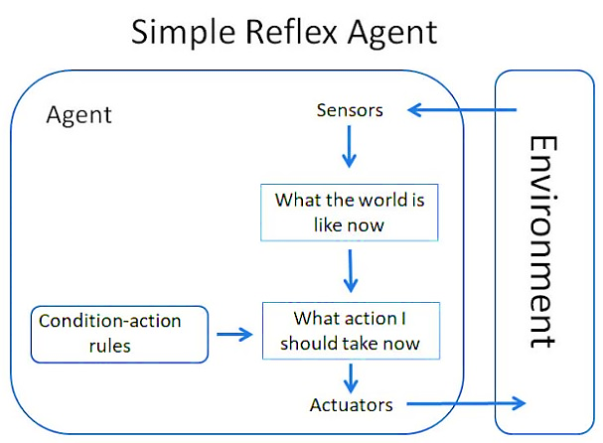
Simple Reflex Agent

Slide 11
Example 1: Automatic Door System
Condition: If motion is detected near the door → Open the door
Condition: If no motion for 10 seconds → Close the door
Limitations:
Very limited intelligence
Can go to infinite loop in partial observable environment

Slide 12
Model-Based Reflex Agents
A Model-Based Reflex Agent is an improved version of a simple reflex agent. It remembers past percepts and maintains an internal model of the environment.
Working: (Condition-Action Rules with Memory)
It stores past percepts in an internal state.
It updates its internal model based on new percepts.
It uses this stored information to make better decisions.
Model: (how things happen in the world)
Agent state information update required two things
How the world is evolving
How agent’s action is affecting the world

Slide 13
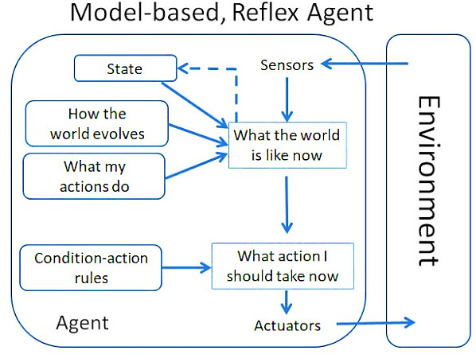
Model Based Reflex Agent

Slide 14
Example: Smart Vacuum Cleaner
Condition: If the area is clean, then move to the next area.
Condition: If the area is dirty, then clean it.
Condition: If the battery is low, then return to the charging dock.
Two key features that make this a Model-Based Reflex Agent:
Memory of Past States (Internal State)
  It remembers which areas are clean so it doesn’t waste time rechecking them.
  A simple reflex agent would keep moving randomly, but this agent optimizes movement.
Adapting Behavior Based on Battery Level
  The agent monitors its own battery and returns to the charging dock when needed.
  A simple reflex agent would not check its battery status, potentially running out of power in the middle of cleaning.

Slide 15
Goal Based Agents
A Goal-Based Agent chooses actions based on a defined goal rather than just reacting to percepts. It searches for a sequence of actions that lead to the goal.
Working: (Goal-Based Planning)
The agent defines a goal (desired outcome).
It evaluates different action sequences.
It selects the best action that leads toward the goal, so every action taken to minimize distance to the goal state
It is more flexible agent then model-based reflex agent

Slide 16
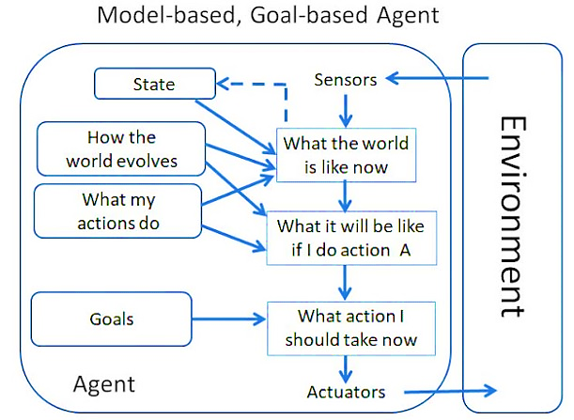
Goal Based Agents

Slide 17
Example: GPS Navigation System
Case1: If the destination is far, find the shortest path.
case2: If there is traffic, then reroute.
Case3: If the road is closed, then recalculate.
Why It’s a Goal-Based Agent?
It does not just react; it searches for the best route.
It modifies its path when obstacles appear in order to reach the goal destination through shortest path.

Slide 18
Utility-based Agents
A Utility-Based Agent improves upon a goal-based agent by not just achieving a goal, but finding the most efficient way to achieve it.
Working: (Decision Making with Utility (preferences)
It assigns a value (utility/preferences) to each possible action.
It selects the action with the highest utility.
It balances multiple factors (e.g., speed vs. safety).

Slide 19
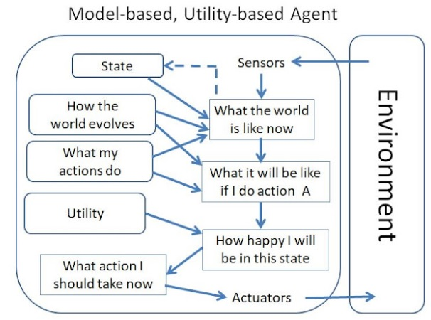
Utility based Agents

Slide 20
A goal-based agent follows simple rules like "Wear warm clothes in winter."
A utility-based agent provides personalized recommendations based on weather conditions.
Example:
  If the temperature is 30°C (hot) → Recommends T-shirt and shorts (utility = 95%).
  If it's 15°C (cool) → Suggests a light jacket (utility = 80%).
  If it’s 5°C (cold) but sunny → Recommends a warm jacket but not too many layers (utility = 75%).
Why it’s a utility-based agent?
  It balances warmth, comfort, and practicality instead of just following a fixed rule.
95% utility (T-shirt & shorts for hot weather) → Best choice
80% utility (Light jacket for cool weather) → Less optimal
70% utility (Heavy coat on a warm day) → Worst choice

Slide 21
Learning Agent
A Learning Agent improves over time by learning from past experiences. It modifies its behavior based on feedback.
How It Works (Learning Process)
The agent starts with basic rules.
It observes outcomes and compares them to expected results.
It adjusts its decision-making using learning algorithms.

Slide 22
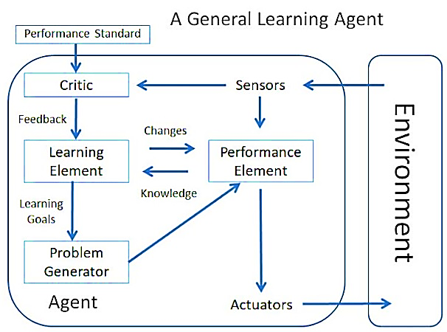
Learning Agent

Slide 23
Learning Agent
Learning Element: Makes improvement in system by learning from environment
Critic: Give feedback about agent’s performance based on the standard
Performance Element: Selects the action to perform
Perform Generation: Suggest the action } new info gain

Slide 24
Example: Spam Email Filter
Condition: If the email contains “Lottery Winner” → Mark as spam.
Condition: If the user moves an email to spam, update filters.
Condition: If a spam email is not detected, improve detection model.
Why It’s a Learning Agent?
It adapts over time to new spam techniques.
It modifies its condition-action rules dynamically.

Slide 25
Agent Type | Uses Memory? | Uses Goals? | Optimizes for Best Action? | Learns Over Time? | Example
Simple Reflex Agent | No | No | No | No | Automatic door, Basic thermostat
Model-Based Reflex Agent | Yes | No | No | No | Smart vacuum, AI thermostat
Goal-Based Agent | Yes | Yes | No | No | GPS Navigation, Chess AI
Utility-Based Agent | Yes | Yes | Yes | No | Self-driving cars, AI stock trading
Learning Agent | Yes | Yes | Yes | Yes | Spam filters, Personal assistants

